Slide 1

Assessment and Evaluation System in Telangana:
Navigating Challenges, Exploring Prospects
@ Osmania University
Based on an ISB Study for TSCHE & CCE-Telangana
Chandrasekhar Sripada, Clinical Professor (OB)

Slide 2

Agenda
Higher education in Telangana – the context for a study on assessments
ISB study – Aims and scope
Methodology
Findings
International best practices
Key recommendations
Implementation challenges – exploring success pilots

Slide 3
Our Mandate
Study, analyze, and evaluate current assessment systems in collegiate education in Telangana.
Find to what extent they are assessing for future skills and helping our students to be more employable.
Recommend a renewed evaluation system that will assess students for future skills.
Implicit expectation
Changes in assessment in any case will trigger the need to change in other aspects. Therefore identify and surface other changes required in the curriculum, pedagogy, teacher –readiness, resources, and infrastructure

Slide 4
Scope & Methodology
Scope: degree studies (undergraduate programs) in Arts, Science, and Commerce and associate streams/disciplines (technical education such as engineering degree excluded )
Mixed methods study :
  Survey: A random sample across locations, regions, and demographic differences
    Questionnaire survey was administered to 3322 students and 909 teachers
    Of which 692 students (21%) and 258 teachers (28%) responded
  Interviews: principals, teachers, and staff at 14 colleges (6 urban, 8 rural) and 10 state-run and 4 autonomous colleges were interviewed. Additionally, six vice-chancellors were interviewed.
  Focus Group discussion: 10 industry leaders across e-commerce, IT services, Automotive, Manufacturing, and hospitality were met to understand industry views/needs

Slide 5
Major findings
41% of teachers are unhappy with the present evaluation and examination system.
Only 14% of the students think the present evaluation system is > 80% effective.
Students want industry-desired skills to improve their employment prospects and want to learn and be assessed through internships, practical field studies, and projects.
Some autonomous colleges have already moved toward ‘formative assessment.’
The state has made significant progress in the use of technology in many areas like admissions and student records management. E.g.: DOST
• Industry leaders point to the need to assess Life & Work skills:
  Social and emotional skills,
  Strong work ethic
  Critical and integrative thinking
  Communication and
  Collaboration/teamwork
• Competency assessment in addition to marks sheets/grade transcripts -need of industry

Slide 6
Learnings from international best practices
Extensive use of Technology for teaching and assessment
Focus on Student-Centered Learning
Use of application-oriented assessment tools (Quizzes, self-reviewed and peer-reviewed reports, live projects, group projects, internships, virtual labs, industry visits)
Continuous evaluation with academic support (performance-based assessments, self-assessments, and peer assessments)
Transparency and communication in the assessment system
Tech tools for online evaluation (LMS, surveys, VC, test tools, AI-powered tools)
Adopting Bloom’s Taxonomy

Slide 7
Key Recommendations (1/3)
• Emphasize ‘formative assessment’ - progressively provide 50% weight Simultaneously, de-emphasize rote learning
    reduce summative assessments (annual exams)
    innovate assessment designs and methods - align with future needs.
      Examples: field visits, projects studies, internships, industry visits, problem-solving projects, continuous assessment and feedback through periodic quizzes, online simulations, and reflection papers, etc.
• Focus on assessing 21st-century skills
    i) critical and integrative thinking,
    ii) social and emotional skills,
    iii) learning to learn, and
    iv) the ability to thrive in an increasingly digitalized world.
• Invest in teacher training and upskilling.
Create an “assessment methods bank” (beyond ‘question’ bank).

Slide 8
Key Recommendations (2/3)
Recommendations in 4 Clusters
Phased Change Implementation
  Plan and execute carefully selected pilots,
  Co-opt stakeholders,
  Identify, train, and deploy change agents across levels/hierarchies,
  Cascade changes over a 2–3-year period for effective results.
• Governance for change :
  Create a standing task force to govern, steer, and drive changes
  Develop a maturity model to assess progress,
  Make mid-course corrections as required.
• Set up Centers for Innovation in Evaluation and Assessment
In the long run, move from ‘assessment for learning’ to ‘assessment as learning’.
Cluster 1: Revised assessment and evaluation methods
Cluster 2: Teacher training & readiness
Cluster 3: Policy changes & governance
Cluster 4: Resources, funds, infrastructure, and eco-system support

Slide 9
Key Recommendations (3/3)
1. Create, fund, and set up a Centre for Innovation in Assessment and Evaluation in every university.
2. Let task forces of enthusiastic change leaders run these centers of innovation (not hierarchies)
3. Appoint younger and new-generation teachers who are experts across subjects on this task force and are interested in new-age assessments.
4. Create consultation mechanisms with students and employers.
5. Design exemplary new assessment methods in the next 6 months.
6. Pilot these newly designed assessments in the second half of this academic year (2023-24) in at least 5 colleges across select subjects. Autonomous colleges may be selected for this on priority
7. Study the results and scale for wider deployment next year.

Slide 10
Implementation challenges
Awareness, acceptance and adoption
Infrastructure and resources
Teacher training
Creation of assessment banks
Adjustments to pedagogy to encourage critical thinking and applied learning
Ongoing institutionalized industry engagement
Continued commitment to innovations in assessment by educational leaders and administrators

Slide 11
Pilots: Key next steps to success
Create assessment banks at least in 3 subject areas – one each from arts, science and commerce.
Build “playbooks” and “examples” for integrating curriculum, pedagogy and assessment in each of the above.
Hold workshops with experts to ideate, learn and execute the above.
Run pilots in 5 colleges with clear post-pilot results measurement matrix vis-à-vis baseline.
Assess success and explore scaling

Slide 12
Level 1
✓Life and work skills defined
✓Competency maps drawn
✓Preliminary assessment methods identified and deployed
✓Formative assessment moves to 20% of all evaluations in 70% of all colleges for 70% of courses
✓Minimum technology support provided
Level 4
✓Changes embedded across the education value chain:
teacher selection and staffing, training, curriculum design, pedagogical innovations, certification, industry connect
✓ Best performers recognized and rewarded
✓Ongoing governance and review mechanisms in place
Level 3
✓50% of all assessments get to be formative in 100% of all colleges for all courses
✓Industry recognition for competencies formalized
✓Expanded assessment methods bank in place and fully utilized
✓>75% teachers fully trained
✓Tech solutions for “adaptive assessments” built
Level 2
✓Based on learnings from level 1, competencies are refined and classified into I) beginner, II) intermediate and III) advanced
✓Curriculum and pedagogy revised to reflect learning of competencies
✓Assessment banks designed.
✓Formative Assessments move to 30 % of all evaluations in 80% of all courses in 90% of all colleges
✓Advance technology support provided
Assessments Maturity Model

Slide 13
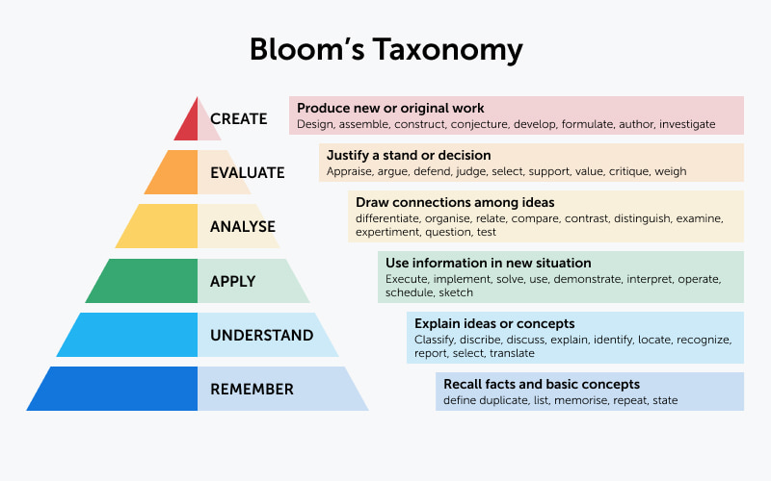

Slide 14
Key Educational Administrators Interviewed
Body/Organization | Date | Role of the interviewee
Kakatiya University, Warangal | March 27, 2023 | Vice Chancellor, Registrar, Controller of Examinations
Mahatma Gandhi University, Nalgonda | March 28, 2023 | Vice Chancellor, Registrar, Controller of Examinations
Palamuru University, Mahbubnagar | March 28, 2023 | Vice Chancellor, Registrar, Controller of Examinations
Telangana University, Nizamabad | March 29, 2023 | Vice Chancellor, Registrar, Controller of Examinations
Osmania University, Hyderabad | April 3, 2023 | Vice Chancellor, Registrar, Controller of Examinations
Satavahana University, Karimnagar | April 10, 2023 | Vice Chancellor, Registrar, Controller of Examinations

Slide 15
14 Colleges Studied
Body/Organization | Date | Role of the interviewee
Government Degree College for Women, Begumpet | January 23, 2023 | Principal, Controller of Examinations, Heads of Department, IQAC Coordinator
Government City College, Hyderabad | January 24, 2023 | Principal, Controller of Examinations, Heads of Department, IQAC Coordinator
BJR College, Hyderabad | January 25, 2023 | Principal, Heads of Department, IQAC Coordinator
Telangana Social Welfare Residential Degree College- Arts (Ibrahimpatnam, Budvel)- Ghatkesar | February 27, 2023 | Principal
Telangana Social Welfare Residential Degree College- Science (Ibrahimpatnam, Budvel)- Ghatkesar | February 27, 2023 | Principal
Telangana Social Welfare Residential Degree College- Life Science (Ibrahimpatnam, Budvel)- Ghatkesar | April 11, 2023 | Principal
Kakatiya Government College, Warangal | February 27, 2023 | Principal, Heads of Department, IQAC Coordinator
Vaagdevi Degree and PG College, Hanamkonda | February 27, 2023 | Principal, Heads of Department, IQAC Coordinator
Govt Degree Arts and Sciences College, Kamareddy | February 28, 2023 | Principal, Heads of Department, IQAC Coordinator
Sandeepani Degree College, Kamareddy | February 28, 2023 | Principal, Heads of Department, IQAC Coordinator
RBVRR Reddy Womens College, Hyderabad | March 1, 2023 | Principal, Heads of Department, IQAC Coordinator
Nizams College, Hyderabad | March 1, 2023 | Principal, Heads of Department, IQAC Coordinator
Bhavan’s Vivekananda College, Hyderabad | March 1, 2023 | Principal, Heads of Department, IQAC Coordinator
Government Degree College, Paloncha | April 6, 2023 | Principal, Heads of Department, IQAC Coordinator

